Slide 1

Bridging the Gap Between CBDS and CIE
Regional Employment Services
Spring 2025

Slide 2

Welcome
Agency Background:
Regional Employment Services is composed of people dedicated to creating, in partnership with others, innovative, rewarding and genuine employment opportunities for individuals with intellectual and developmental disabilities. Our goal is for individuals to participate fully in their communities as contributing members of the work force. We have been successful in helping individuals succeed in finding, keeping, and growing in their jobs since 1998.
Regional Employment Services
Department of Developmental Services
Central/West

Slide 3




Today’s Agenda
Bridging the Gap: CBDS to CIE
Learn about tools that support intentional, person-centered planning for cultivating thoughtful goals and supports.
Explore Charting the Life Course, RES Screening Tool & resources. Connect the 4 E’s and explore new ways to think about goals, supports and teaching strategies.
Experience the tools in action as you apply them in a small group activity.
Consider how you can translate these tools and concepts to a range of Environments, starting with where you’re at.

Slide 4
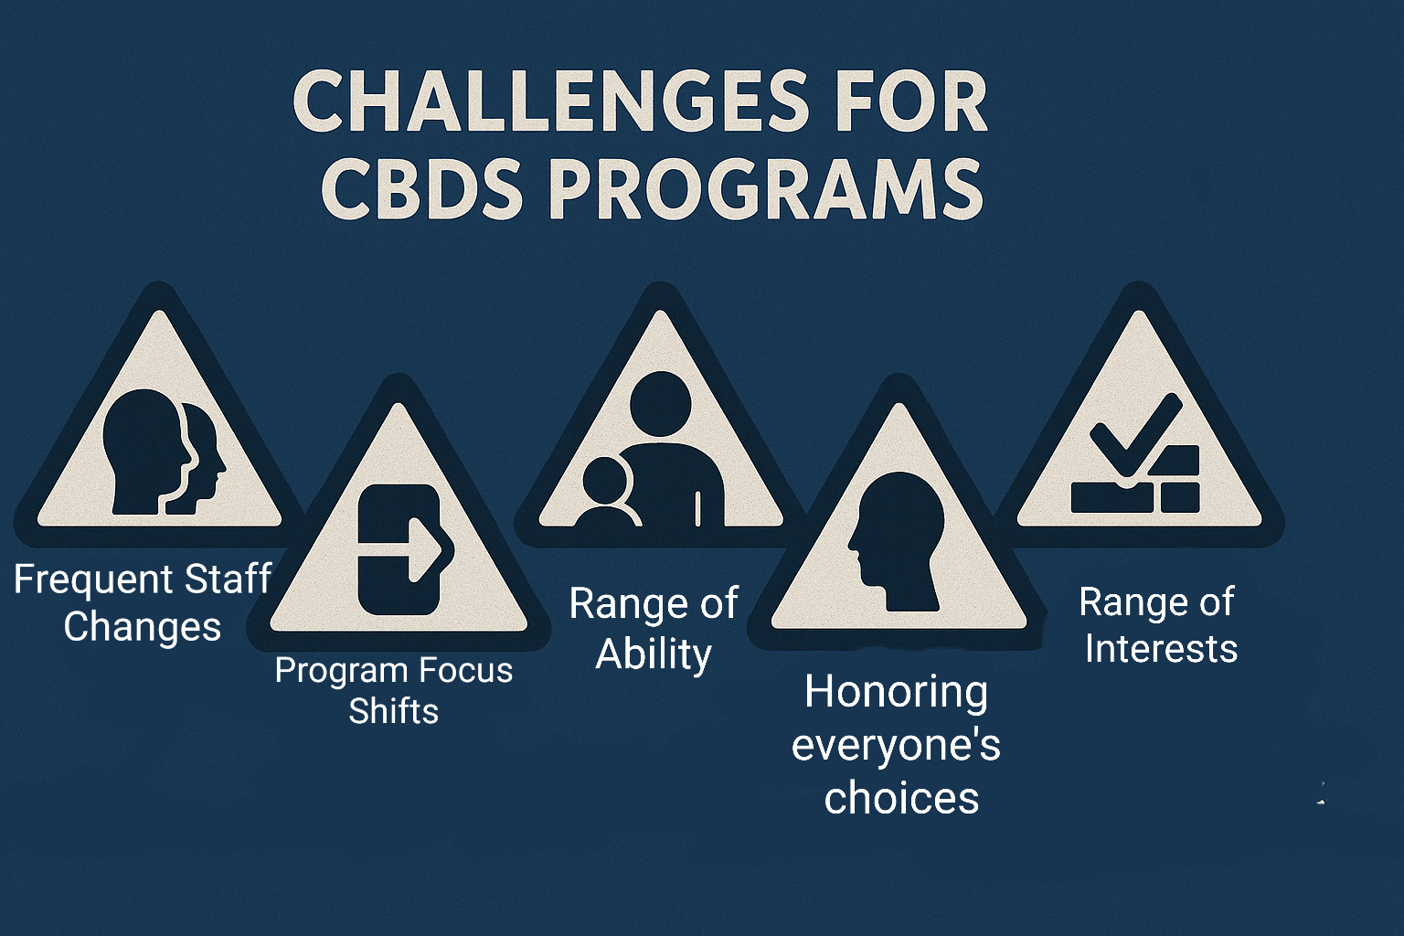
Challenges for CBDS Programs

Slide 5

How to combat challenges
Make room for folks to advance. It is easier to step down after finding you’re not ready than to find motivation to keep going when you’re disengaged.
Avoid learned helplessness: Find opportunities for people to do for or finish for themselves, they deserve the opportunity to try & make meaningful decisions about how to grow towards independence.
Try it, even it doesn’t work, you tried and learned what doesn’t work.

Slide 6

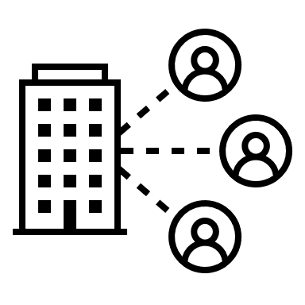


Timeline
2020 – 2022: Virtual & Disconnected COVID
Future: Employment-Driven Programming
CBDS as Alternative to Employment
2025: Exploration towards Employment

Slide 7
Blueprint 2.0 Check In
According to most recent Blueprint updates CBDS Programs should:
Offer
Offer person-centered planning & exploration
Make
Make employment discovery & exploration a core part of everyone’s CBDS experience
Embed
Embed employment exploration activities into weekly schedules
Use
Use interest inventories & visual resumes & situational assessments as accessibility tools
Assign
Assign staff to support individualized employment exploration
Track
Track personal preferences, strengths & support needs using visual, accessible methods

Slide 8
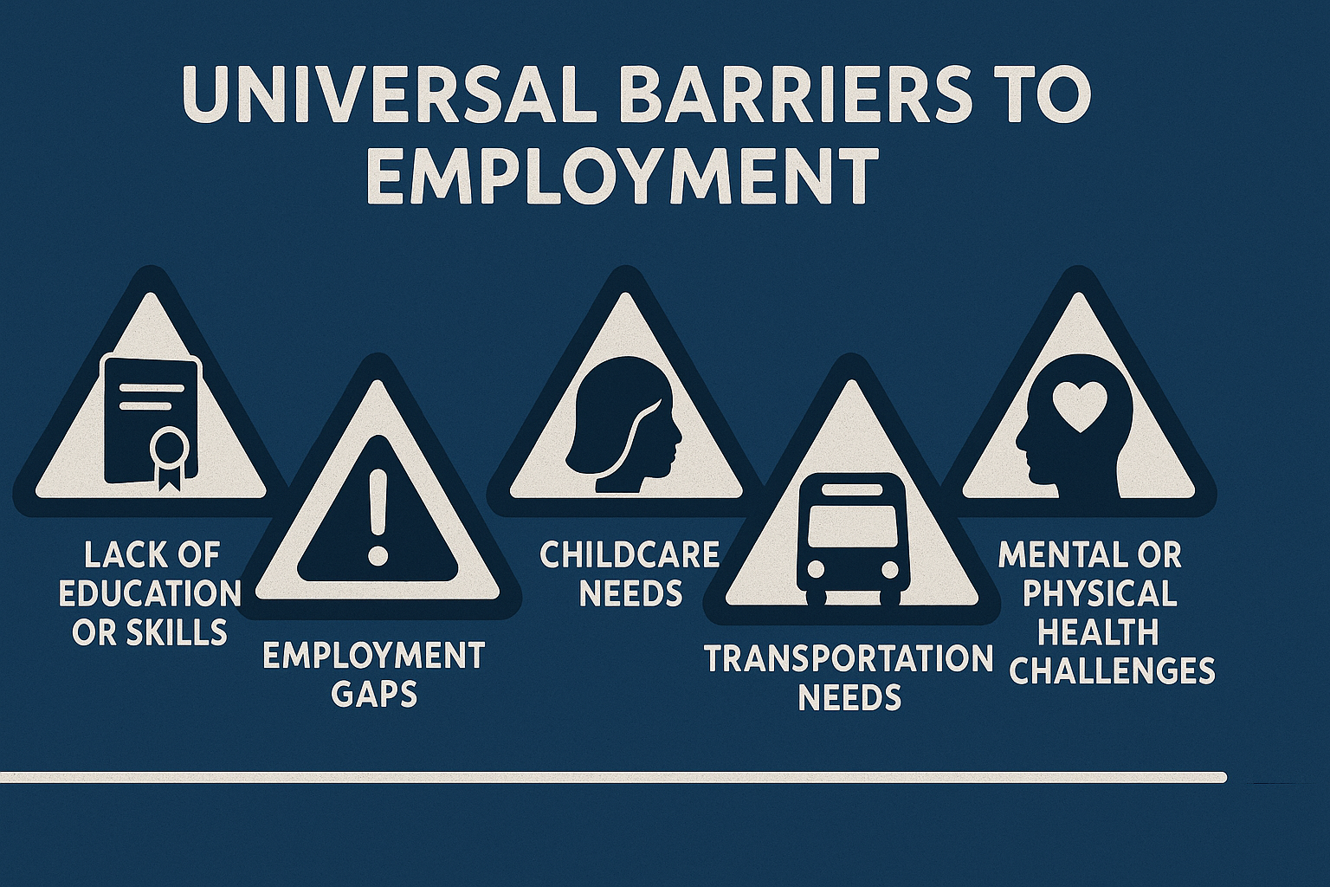
RES Tool Development with Tina Macy

Slide 9
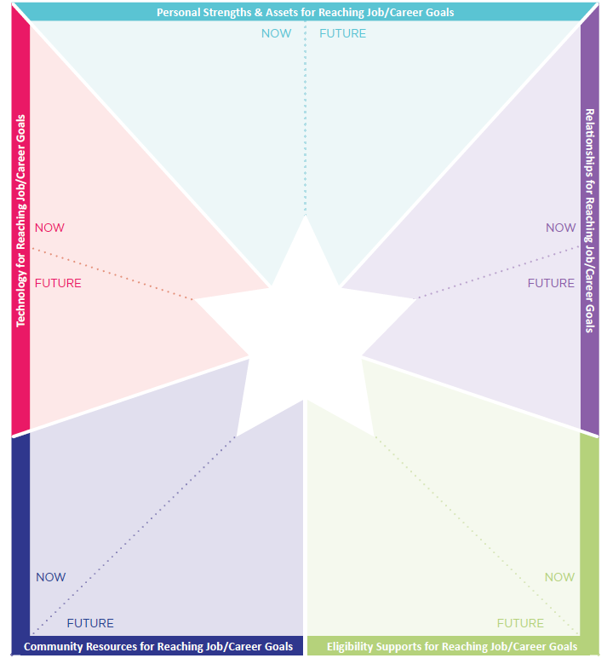
Enhance CtLC with intentional questions
What have coworkers or supervisors appreciated about you? What about friends and family members?
What tools, technology, supports do I use in my life right now that help me to work/participate in activities more independently?
Who is in your family circle? Friend circle? Community connections (store clerk, library, hobbies, sports, program attending/attended in past)? Current job? Past Jobs?
Do I have or am I eligible for state employment supports (DDS, MRC, DMH, other)? CBDS or other support services?

Slide 10
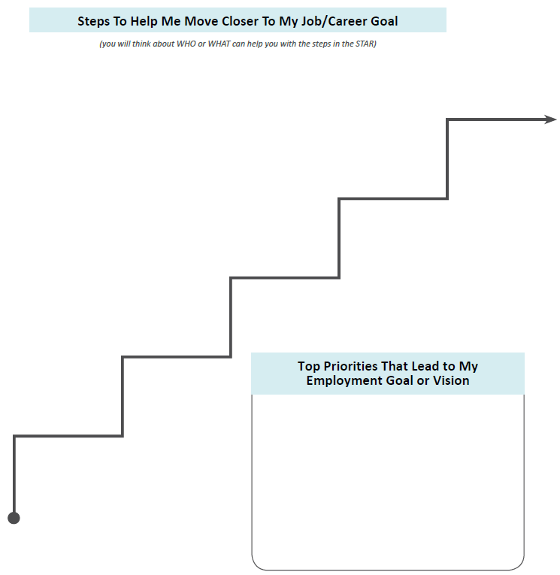
Intentional questions help identify intentional steps
Long-term goal for employment?
What experiences do I need to have in order to identify my goals? Career exploration, job shadow, volunteering
What things do I need to apply for or accept a job? work Identification documents, transportation, resume, interview clothes
Do I need additional training, education, license? What supports or resources will I need?
What is my short-term goal for employment?

Slide 11
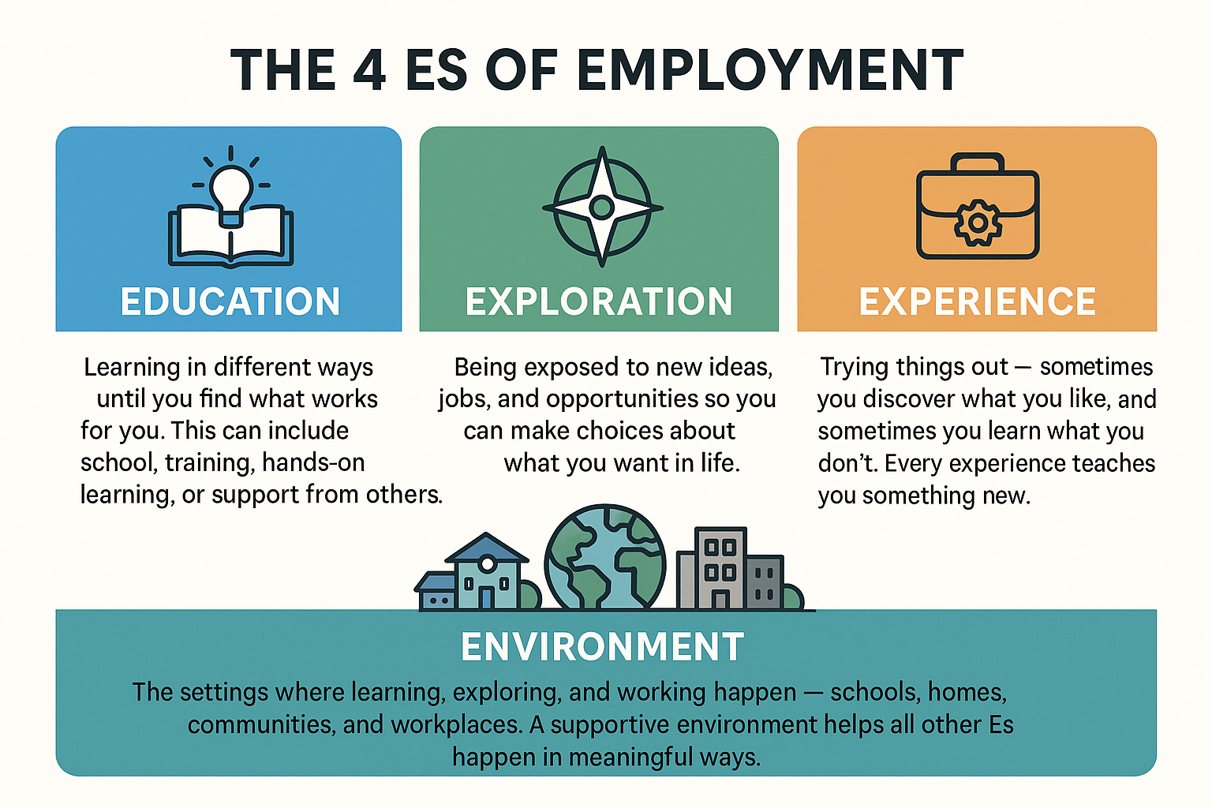
The 4 Es of Employment

Slide 12
Employment Readiness: Major Life Domain Grid
Domain | Exploration | Experience | Education | Learning Environment
Mental & Physical Health | Identify how mental/physical health affects daily functioning and work | Try low-stress volunteer or part-time tasks with wellness check-ins | Participate in stress reduction activities that promote physical health | Learn self-awareness and regulation techniques, mental health literacy, and stress management CBDS: Health education workshops Community: Local wellness programs, gym, therapy Wellness check-in discussion group
Healthy Decision-Making, Risk & Conflict Management | Reflect on past conflict situations and risk-taking behaviors | Role-play conflict resolution; shadow workplace situations | Reflect upon daily decision making process and expand decision-making opportunities | Participate in decision making skills and interpersonal skills training CBDS: Structured group activities Community: Peer mediation, group therapy, work placements
Routine & Adaptability | Explore how routines support success (e.g., energy, focus, mood) | Use a planner/schedule to complete daily CBDS tasks independently | Learn time management, executive functioning, and flexibility skills | CBDS: Supported daily routines, calendar building Community: Independent travel to a consistent weekly activity
Access to Basic Resources | Map out current access to housing, food, transit, etc. | Understand how work affects and is affected by these resources | Visit local resource centers, simulate budgeting or transit use | Attend workshops on budgeting, accessing benefits, or transportation training CBDS: Budgeting simulations, resource navigation Community: Housing clinics, food pantry volunteering
Social Support Engagement | Identify current natural and provider-based supports | Attend support groups, mentorship or peer support networks | Learn advocacy skills, relationship-building, communication techniques | CBDS: Peer-led circles, provider check-ins Community: Community centers, job clubs, family involvement workshops
Tips for Goal Setting:
• Use this grid to develop SMART goals with individuals based on where they are in their journey.
• Consider layering activities (e.g., combine routine-building with community transit training).
• Integrate reflective learning by debriefing experiences in CBDS environments.

Slide 13
REFLECTION TOOLS AMPLIFY MEANINGFUL, INFORMED CHOICE
Options Based on Preference: Journals, videos, voice diaries, portfolios
- What did I enjoy or find hard?
- What am I getting better at?
- Do I still want to do this?
Notes:
Definition: Confidence that 'I can do this'
Efficacy Grows When:
- People reflect on their progress
- They see success in each “E”
- They feel supported and capable
Message: Empowerment is the outcome of this leg of the journey. Employment comes next. NOT THIS ONE

Slide 14
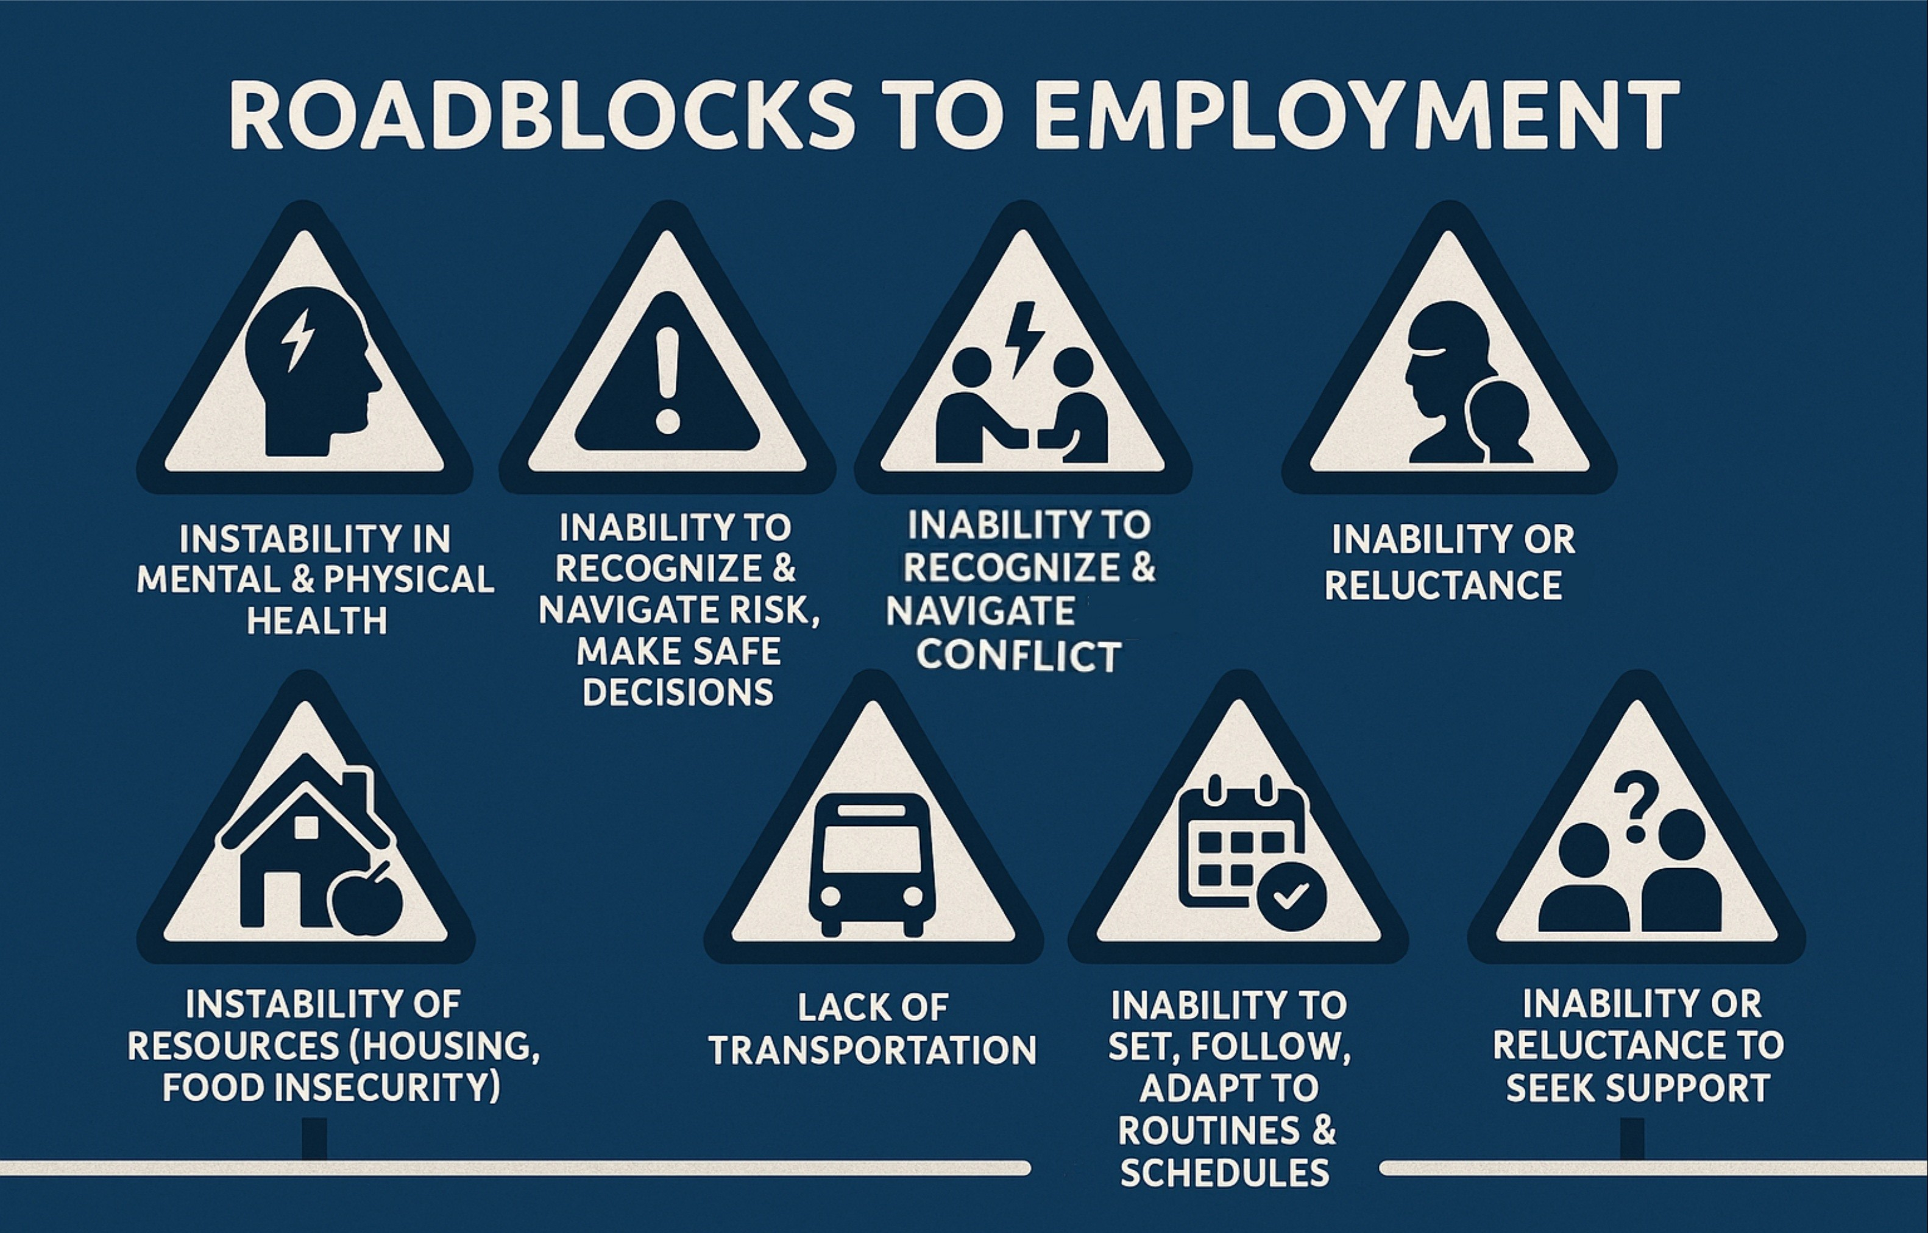
Roadblocks to Employment

Slide 15
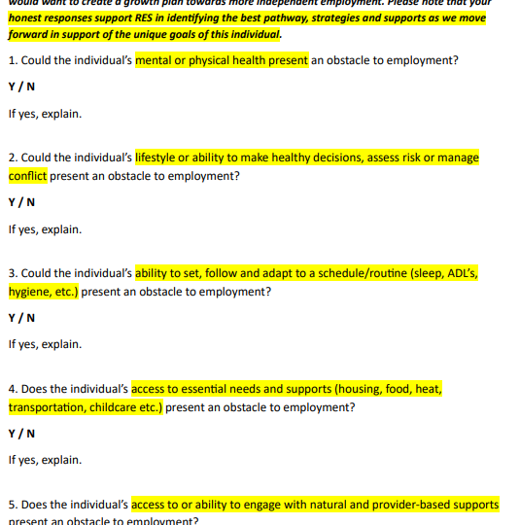


Screening for Readiness, not disqualification

Slide 16
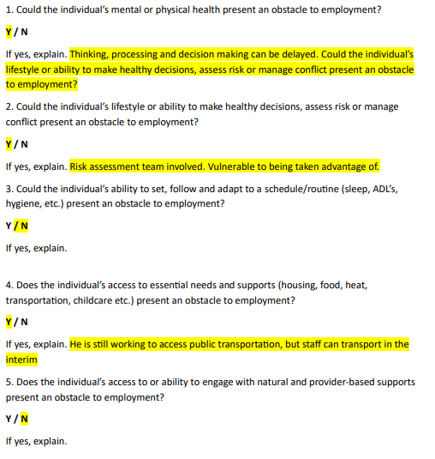
J. Doe’s Screening response from Ind Support Provider
This tool tells us that JD has stable self care, follows a routine and can adapt. They have and engage with support. They will benefit from risk recognition & response training as well practice advocating for themselves. They will need to work on resolving transportation needs safely.

Slide 17

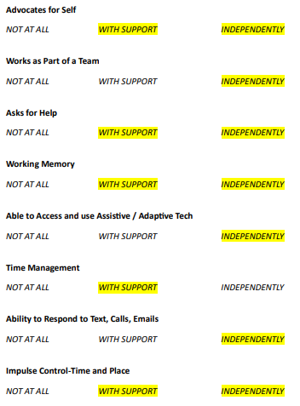
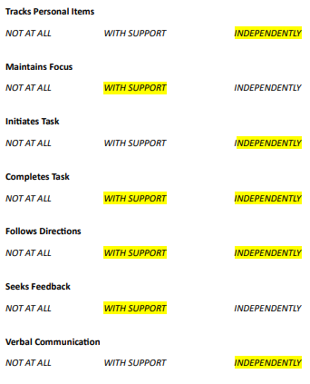
Competencies help reveal strengths & support needs.

Slide 18
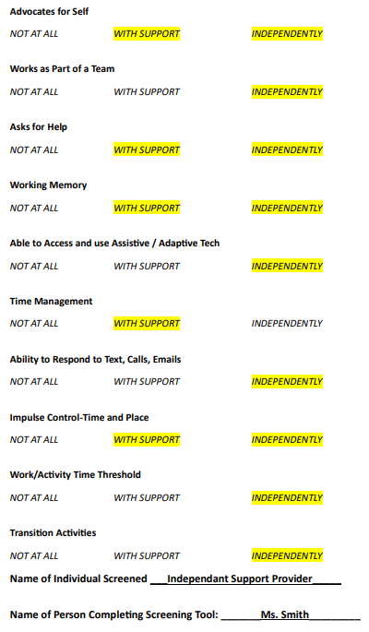
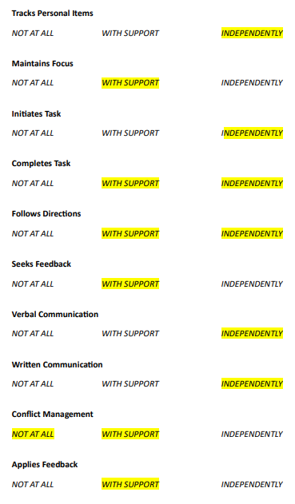
Competencies are based in Executive Function
Independent:
Track personal Items
Initiates Tasks Verbal & Written Communication
Working w Team
Using AT/AD
Respond to Calls, Email, Text
Work Threshold
Transition Activities

Slide 19
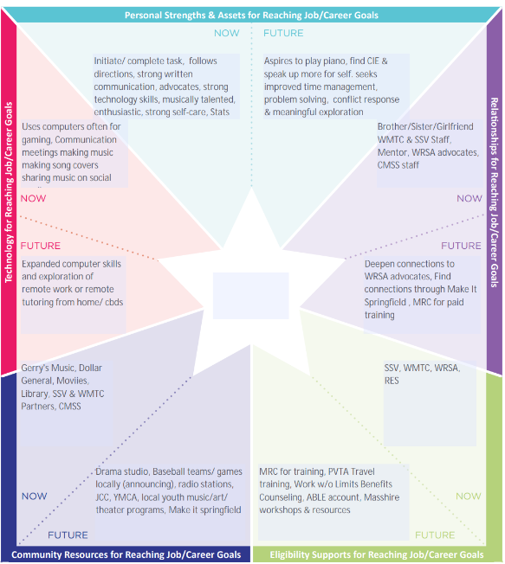
Person Centered Planning

Slide 20
Person Centered Planning (2)

Slide 21



Steps to take
Build Stability – Start with greatest need – Leverage existing competencies & greatest supports
Educate (Expand Competencies) Leverage existing strengths & supports to establish & deepen new skills & advance progress towards stability
Exploration & Plan Revision – Knowing & trying options promotes meaningful, informed choices
Intentional Experiences – Opportunities to practice competencies in a range of environments with increased independence

Slide 22
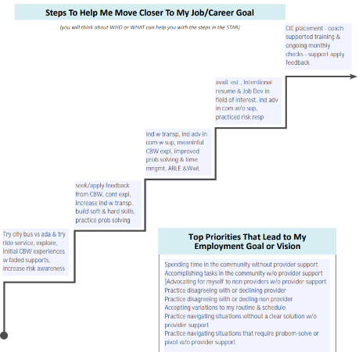
Steps to help me move closer to my job/career goal

Slide 23
Steps to Help Me Move Closer to my Goal
CIE placement with coach and supported training; ongoing job checks, apply feedback from coach and supervisor
Establish availability; update resume, intentional job development in field of interest; advocacy in community w/o support; practice risk response
Increase independence with transportation, advocating in community, problem solving, time mgmt. and meaningful CBW experience w/support
Seek/apply feedback from CBW; continue exploration; increase independence w/ transportation; build soft and hard skills; practice problem solving
Try city bus vs ADA & try ride service; explore initial CBW experiences with faded supports; increase risk awareness
Spending time in the community without provider support
Accomplishing tasks in the community on my own
Advocating for myself to other people in community without support
Practice disagreeing with or declining provider
Practice disagreeing with or declining non provider
Accepting variations to my routine and schedule
Practice navigating situations without a clear solution without provider support
Practice navigating situations that require problem solving or pivot without provider support

Slide 24


Bridging the Gap Between CBDS and CIE
Transition to CIE – Sustained Work with Independence
🎓💼🔓 Paid employment with remote/adaptive supports
Preparation – Job Development & Informed Transition
📱🛠️ 🧩 Job Search, Resume Development, Benefits Counseling, ABLE
Exploration – Community-Based Work, Internships, Informational Interviews
🏢🔍🛠️ Career sampling, workplace exposure, establish references
Competency – Assistive Tech Use, Time Management, Problem Solving
📱⏰🧩 Apps, timers, adapted tools, Observations, Skill specific training
Competency – Experience, Task Management, Focus, Communication
📝🎯💬 Structured tasks, volunteering, remote prompts
Stability – Routine Awareness, Adaptability, Social Supports, Self Reliance
📅🏠 Schedules, Ind. resource access, social engagement
Stability – Assess Interests & Support Needs - ID Resources to ensure access to exploration
🚌👥 Explore options for travel, mentorship, training, assess interest through exposure
Stability – Healthy Decision-Making, Risk, Conflict Management
⚖️🔥🤝 Conflict-resolution roleplays, risk-response roleplays, peer groups
Stability – Healthy Boundaries, Consent, Self Regulation, Communication, Self-Advocacy
💬👥 Educational options, Boundary Setting Roleplays, peer groups, CtL relationship mapping
Stability – Mental & Physical Health, Wellness & Risk Recognition & Response
🧠❤️ Practices to ensure health & wellness, first aid, safety, risk awareness, response & reporting training activities

Slide 25
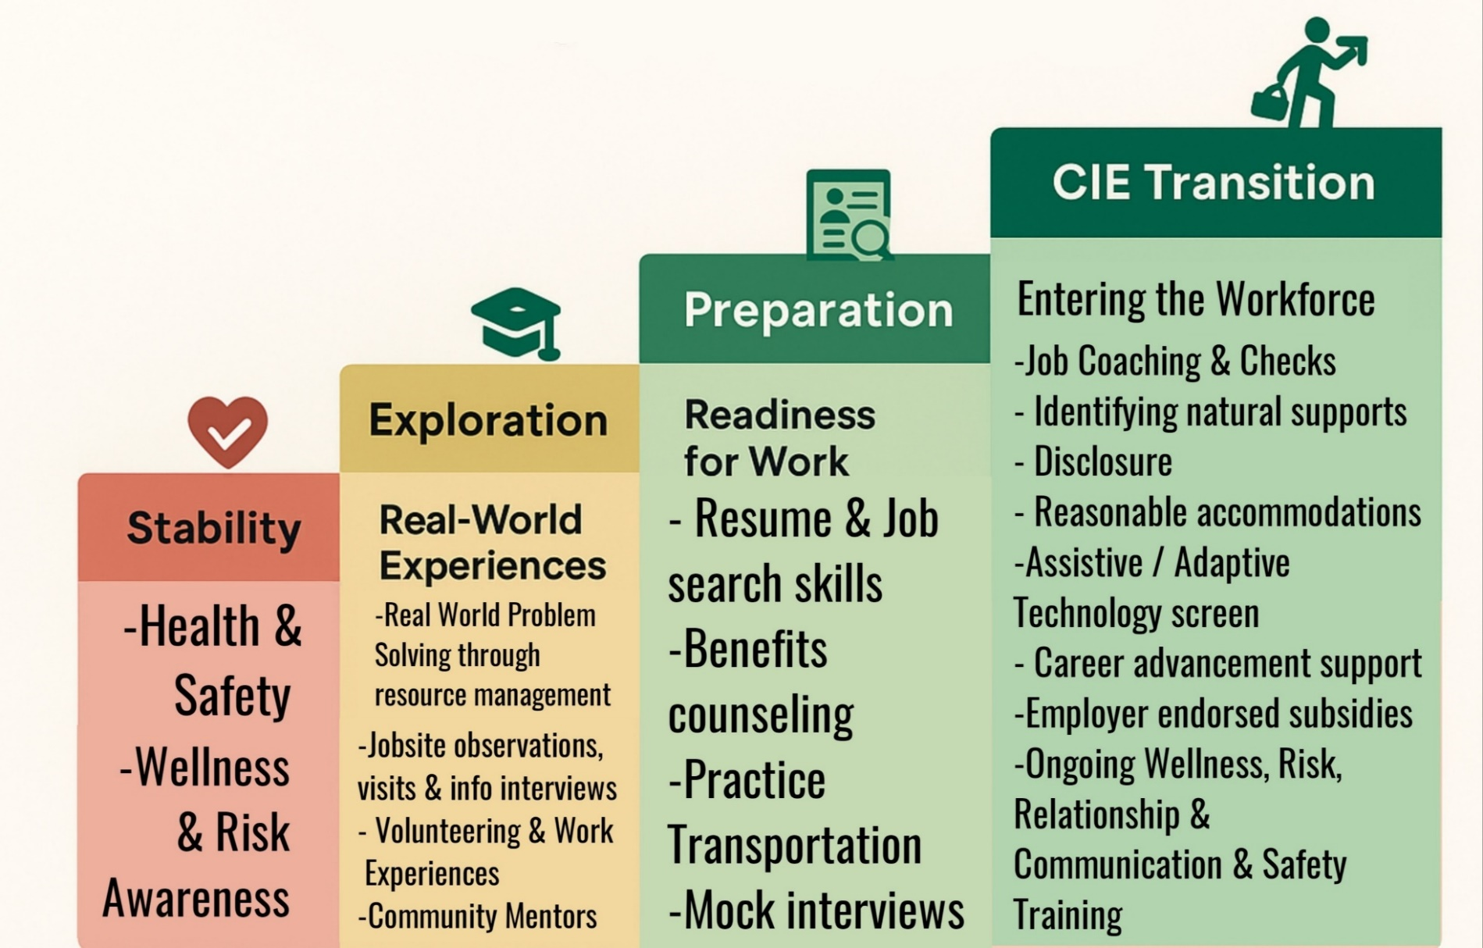
Stability, Exploration, Preparation, CIE Transition

Slide 26
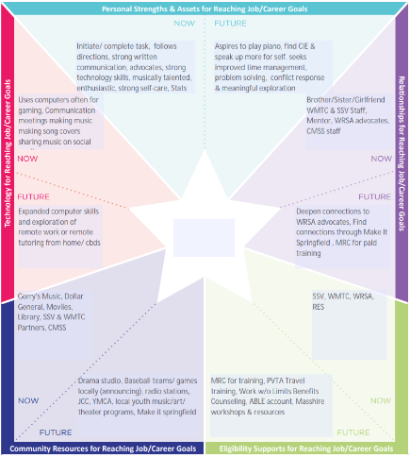
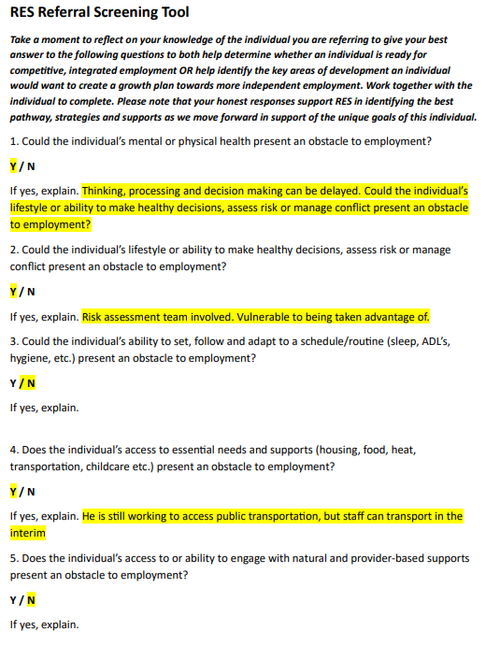
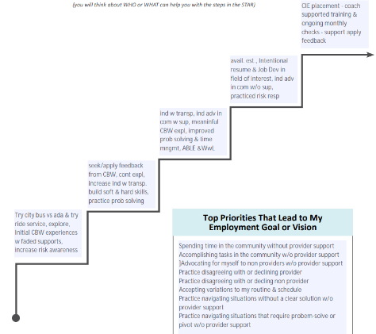
Tools Discussed Support Readiness
ID Skill Strengths & Gaps
ID Vision, Supports & Connections for 4 Es!
ID Readiness Indicators & Barriers to Employment

Slide 27
Let’s Build the Bridge!

Slide 28

Use the Tools to Build Your Bridge!
Small Group Activity
Objective
Each small group will work together to use the completed RES Screening Tool and CtLC Support Star to develop their own completed Trajectory (steps) for the sample individual.
The goal is to identify a thoughtful sequence of person-centered steps toward competitive integrated employment (CIE), using the Grids to consider how to scaffold supports along the way.

Slide 29

Build a Bridge using your New Tools!
Small Group Activity
1. Review the Tools
Read the completed Screening Tool and Support Star for Mr. Smith.
Discuss key themes:
strengths, interests, stability & support needs, and environmental factors.
2. Complete the CtLC Trajectory
As a group, fill in:
Steps Toward the Vision (considering education, exploration, and experiences)
Include supports and environments that would make each step possible.
Use the Grids and Step Guides, but think creatively!
3. Reflect as You Plan
How can your plan promote both stability and competency?
Are you offering a range of entry points so everyone can engage meaningfully?
4. Share Your Completed Trajectory
Select someone to summarize your group’s completed trajectory.
Be ready to explain how the tools and frameworks helped guide your planning.

Slide 30
Core Concepts to Guide Your Planning
Small Group Activity
Think About Stability and Competency:
What steps support foundational stability (routines, supports, well-being)?
What steps build competency (skills, confidence, independence)?
How can you weave both into your trajectory?
The 4 Es: Keep in mind that growth happens through:
Education – learning about options
Exploration – trying things in low-risk ways
Experience – actively engaging in real tasks
Environments – consider where the other E’s happen
Reflection is Key: As you propose steps, ask:
How can we help Mr. Smith and others reflect on what they try?
How can feedback (likes, dislikes, surprises, successes) shape future steps?
How do we honor that learning what we don’t want is just as valuable?
Use the Grids as a Scaffold:
The Grids provided offer ideas for accessible entry points across ability levels.
Consider how programming can be adapted—not watered down—to offer meaningful engagement and support skill building and application. Ensure that every individual has a way to participate, learn & grow.

Slide 31
Feedback & Reflection
Experience: | What aspects of the tools or activities were most helpful in identifying goals for individuals? What challenges or questions came up while using the tools?
Application: | How do you see yourself using these tools in your current role? What adjustments would you make to better align them with your program’s needs?
Impact: | How might these tools influence your approach to goal setting and planning? Who in your organization or caseload could benefit most from this process?

Slide 32
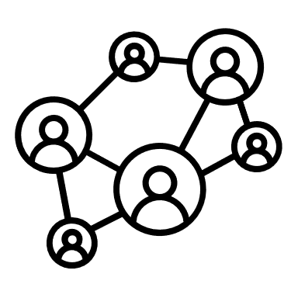
Regional Employment Services Thanks you!
Contact us with questions
Tina Macy
Tina.n.Macy@mass.gov
413-426-8347
Lhea Destromp
Lhea.m.Destromp@mass.gov
Michael Scamardella
Michael.Scamardella@mass.gov
Loren Schuman
Loren.g.Schuman@mass.gov

